Slide 1
C budget models: CO₂ emissions
The other important set of emissions caused by human activities is that of greenhouse gases (GHG).
Various gases contribute to the overall greenhouse effect:
CO₂ is the most common and the reference one (it is a normal component of the atmosphere – 0,04% in volume – not strictly a “pollutant”)
CH₄ (methane) mostly lost during processing
N₂O lost during agricultural activities
…
The overall effect of these gases is measured in terms of the equivalent concentration of CO₂ (CO_{2eq}) by multiplying each concentration by a suitable Global Warming Potential (GWP). For instance, CO₂: 1; CH₄: 28; N₂O: 265; CFC: 4000-10000;…
For example, methane emissions are 14% of global CO₂ emissions but contribute more than one-third of the warming effect.

Slide 2
CO₂ emissions (2)
Despite the low GWP, CO₂ is by far the most important GHG.
Emissions are the result of all combustion processes based on fossil fuels, as well as of the respiration of all living organisms, including vegetation.
Three ways of reducing CO₂ emissions:
CCS (carbon capture and storage): end-of-pipe measure just for large point sources
Fuel reduction (efficiency measure)
Fuel substitution with biomass (efficiency measure): the net carbon balance of bioenergy is (almost) zero over an horizon of few tens of years.
Vegetation however can also absorb CO₂ and stock it through photosynthesis in the biomass. The main way we can absorb carbon from the atmosphere is thus managing vegetation.
Carbon budget models are thus basically forest management models.
P.S. A relevant role is also played by ocean phytoplankton.

Slide 3
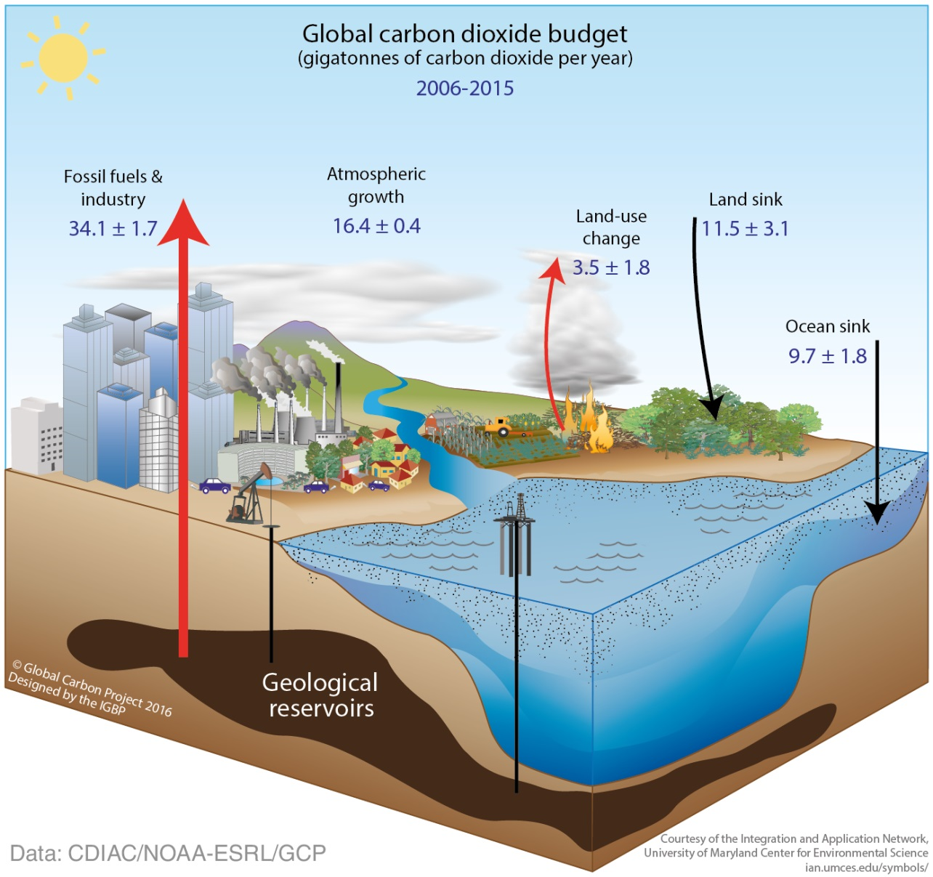
CO₂ emissions (3)
The overall carbon budget of the planet is approximately shown in the figure.
The mass of C in the atmosphere is about 850 Gt (i.e. 3100 Gt of CO₂).
The overall result is an increase of about 16 Gt in 2006-15.

Slide 4
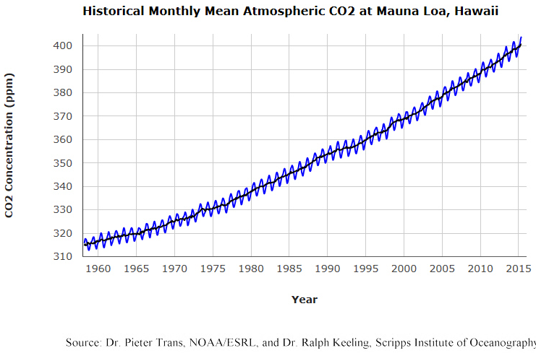
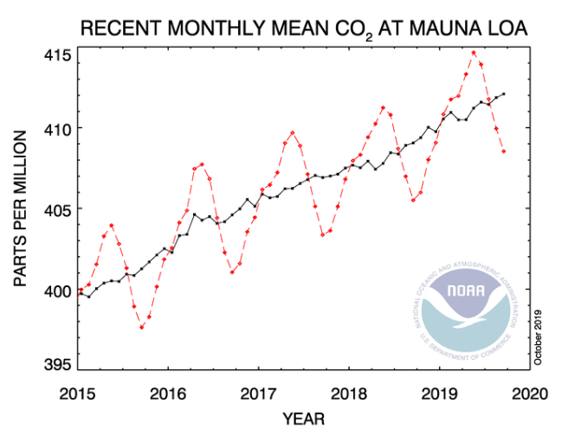
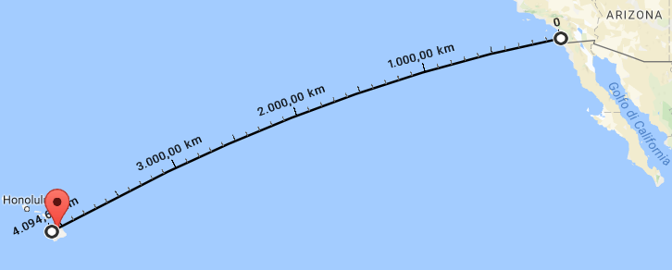
CO₂ emissions (4)
This increase of the CO₂ content of the atmosphere corresponded to an increase in global concentration up to more than 400 ppm.
Note: CO₂ concentration has a seasonal variation due to vegetation activity.
408.54 parts per million (ppm) October 7, 2019

Slide 5
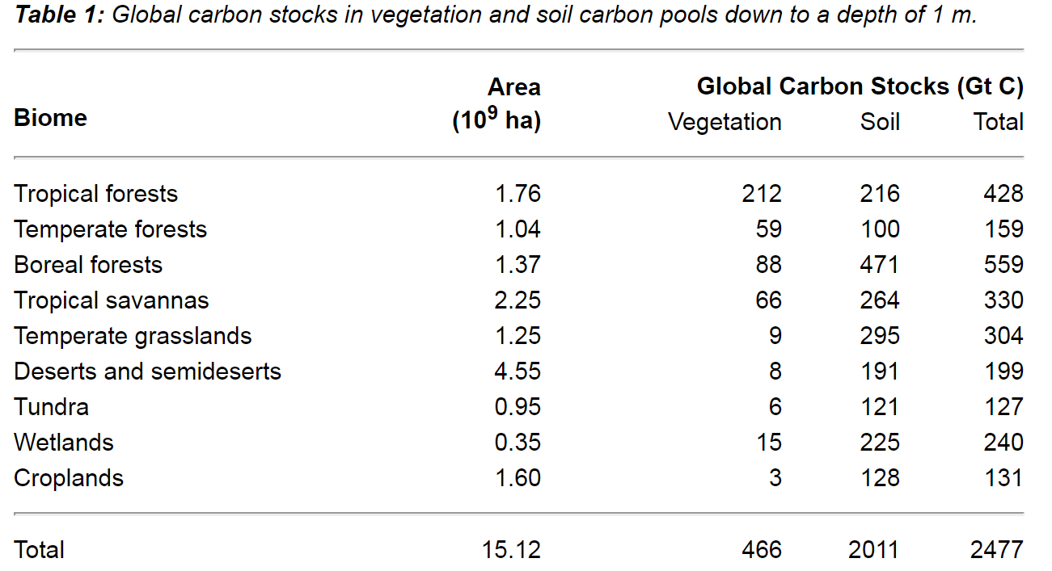
Global carbon stocks
However, most of the world carbon is in the soil (IPCC data)

Slide 6
Carbon budget models
They are basically composed by three compartments:
Vegetation (and soil)
(Direct and indirect) Products
Atmosphere
Models differ for the detail with which each compartment is described.

Slide 7
Carbon budget models (2)
The central block represents the human actions and determines both the evolution of the vegetation and the overall carbon balance in the atmosphere.
(Direct and indirect) Products
Human actions can be of different types:
Deforestation
Afforestation
Bioenergy production (substitution of fossil fuels with biomass, with consequent release of the carbon stored in the biomass)
Thinning
Cuts of different entity
Wood production for various purposes
…
Decisions must be taken on how to manage the living biomass and how to use the dead one.

Slide 8
Carbon budget models (3)
The vegetation compartment represents the dynamic component of the model.
It may include a number of different components and processes.
Main components:
Epigean (above ground) biomass (vegetation)
Hypogean (below ground) biomass (roots)
Litter (dead material fallen on the ground)
Soil (at various depths)
Main processes:
Photosynthesis (growth)
Respiration (death)
Degradation of dead organic material (DOM)
Storage and release in and from the soil
Vegetation (and soil)

Slide 9
Carbon budget models (4)
The atmospheric compartment simply represents a static and infinite pool.
It provides carbon dioxide for vegetation photosynthesis and stores carbon derived from:
Plant respiration
Degradation of DOM
Release from the soil
Use of biomass for energy
Disposal (and hence, degradation) of wooden material used in different applications (construction, furniture, other products and residues)
These releases have quite different dynamics. From few hours (plant life), to years (bioenergy), to centuries (release from the soil).
Atmosphere
Current carbon budget models do not account for concentration changes in the atmosphere (see 2nd module for other models on this topic).

Slide 10
Examples of current models
GORCAM (Austria) implemented in Excel
FORMICA (Austria, Germany)
CO2FIX (Netherland)
CDM-CFS3 (Canada) for Canadian forests
CASMOFOR (Hungary) again in Excel
EFISCEN (Sweden, Finland)
…

Slide 11
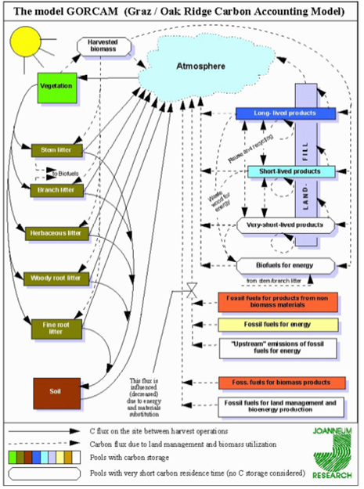
The overall scheme
For instance, GORCAM model has a detailed description of
the vegetation
the soil compartments
the wood uses
Today the most important use of biomass is the production of energy: The primary energy supply of forest biomass worldwide is about 56 EJ, i.e. over 10% of all energy supplied annually. Biomass thus contributes to reduce the use of fossil fuels.

Slide 12
Vegetation model(s)
Photosynthesis:
6H₂O + 6CO₂ (+ solar energy) → C₆H₁₂O₆ + 6O₂
Respiration:
C₆H₁₂O₆ + 6O₂ → 6CO₂ + 6H₂O + high energy internal cells (ATP)
In practice, the dry biomass of a plant is constituted by C for about 50%.
NOTE: the biomass of a plant (a stand, a forest) changes with time, external inputs (e.g. fires), and management decisions (felling, thinning).

Slide 13
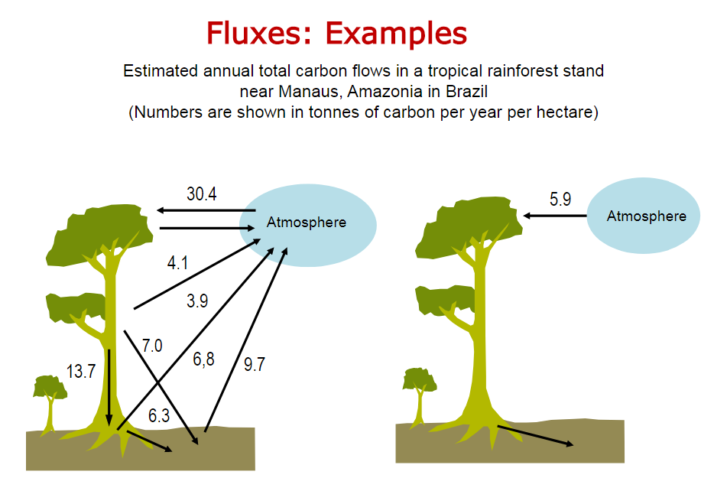
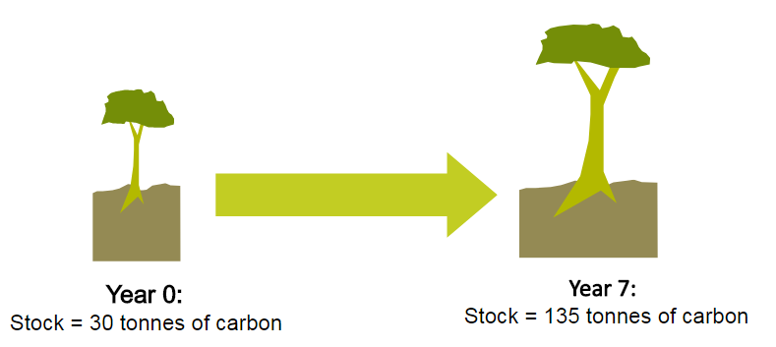

Slide 14
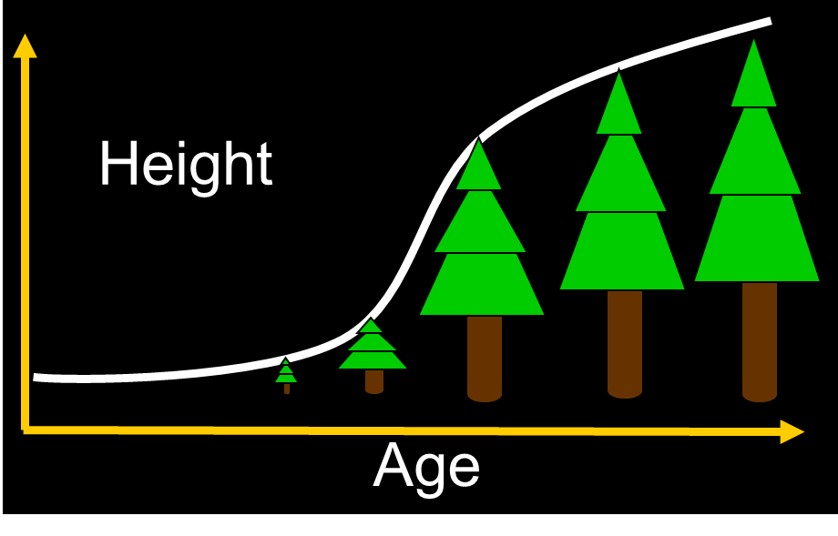
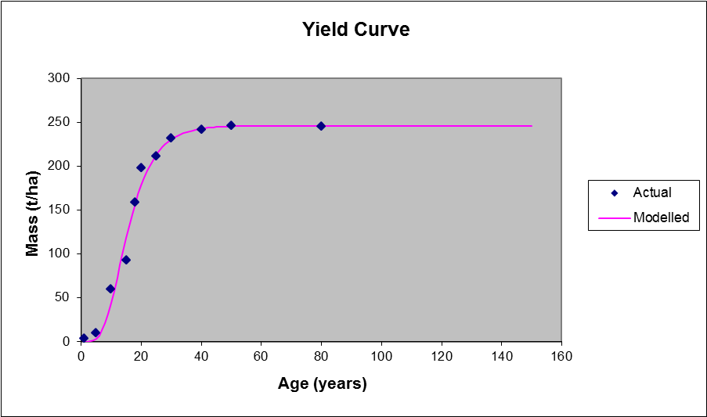
Vegetation model(s) - 2
r, k, B_{max} are species/setting dependent parameters
B_{max} is the carrying capacity of the environment
Ex: GORCAM calculator

Slide 15
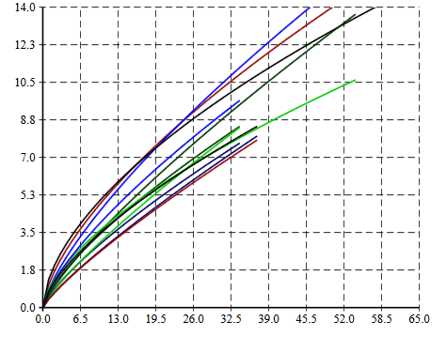
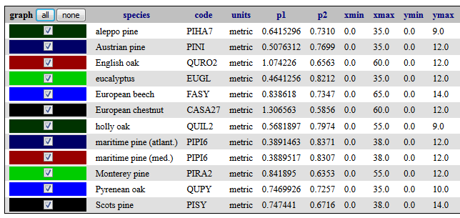
Vegetation model(s) - 3
Biomass is difficult to measure and thus other measurements are usually used to derive it.
ALLOMETRIC FUNCTIONS of the form B=αV^{β} relate biomass or any other value related to tree growth to some easy-to-measure variable V.
A traditional measure is the Diameter at Breast High (DBH).
Ex. Maximum crown width=p1▪Diameter^{p2}

Slide 16
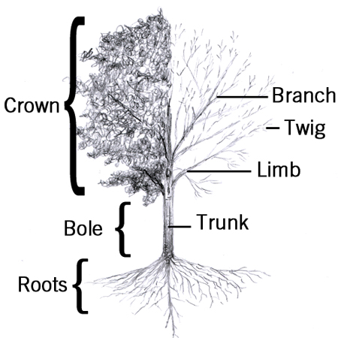
Vegetation model(s) - 4
Allometric functions are used to describe the links between:
Biomass
DBH
Height
Trunk/Stem
Branches
Foliage
Roots
Today some measure can be taken by remote sensing:
Crown dimension by optical/infrared sensors
Height by LIDAR (Laser Imaging Detection and Ranging)

Slide 17
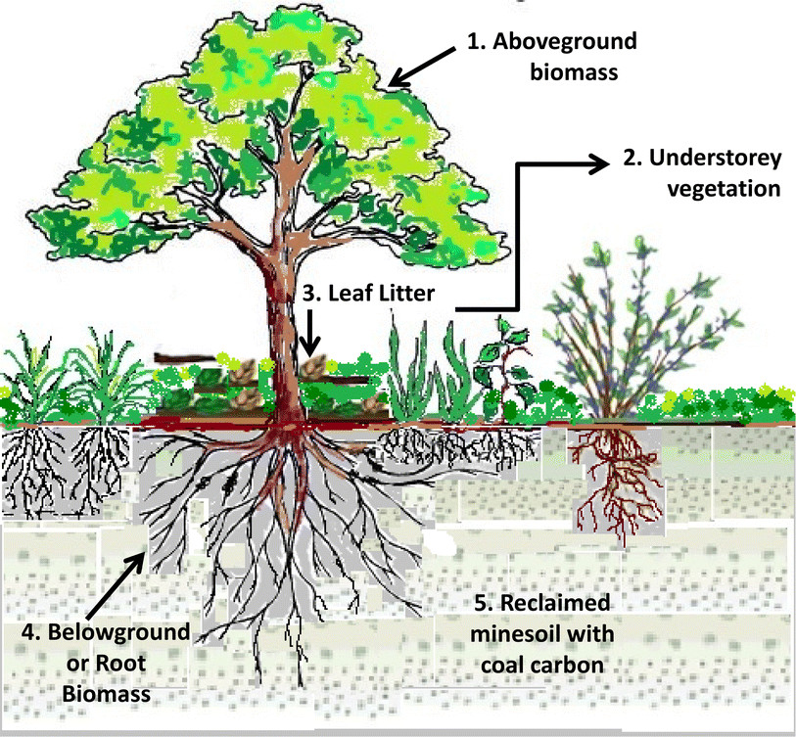
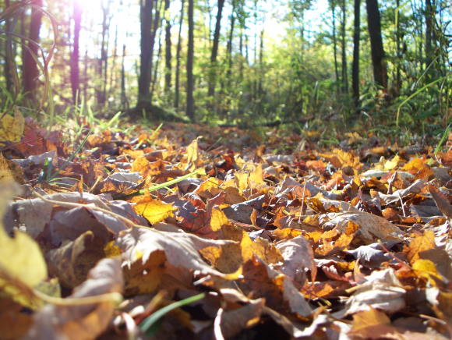
Vegetation model(s) - 5
The organic material falling to the ground forms the litter layer.
Litter (one or more types) is simply a carbon pool which is (linearly) emptied by degradation (i.e. exponential decay), while its C output is stored in the soil (one or more layers) from which carbon is partly taken from roots and partly returns to the atmosphere.
Litter forms naturally and is increased by forestry operations.

Slide 18
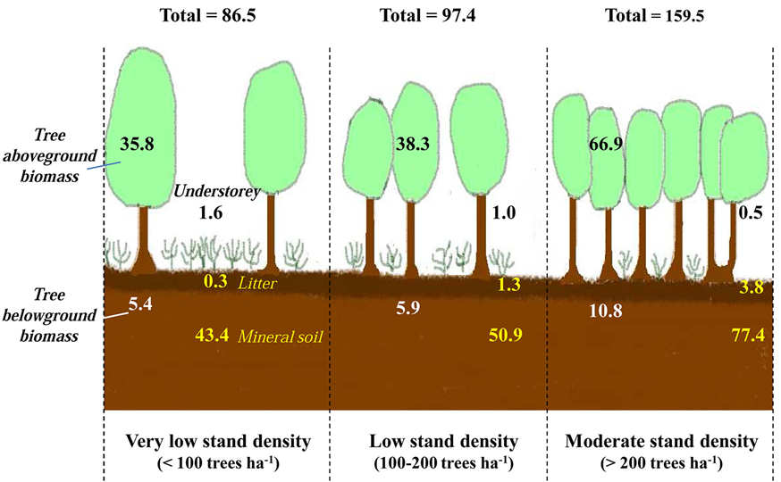
Vegetation model(s) - 6
Depending on the site and the type of vegetation, the carbon pools in a (unperturbed) forest always reach an equilibrium condition with a certain C stock, but no more sink (C sequestered = C released).
NOTE: the time constants of the lower layers of soil may be of the order of hundreds years.
This means the equilibrium is reached in several hundreds years.

Slide 19
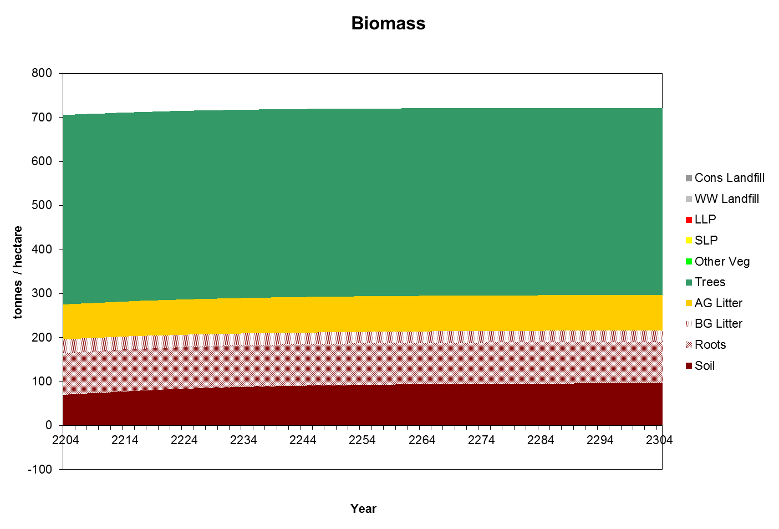
Unperturbed forest

Slide 20
Forest management
Besides external inputs (e.g. fires, parasite invasions, air pollution, acid rains,…), the dynamics of a forest is governed by management choices.
The components of the management actions (decision variables) are:
When to cut trees (usually a periodic decision)
How much to cut (% of biomass removed)
NOTE:
cutting operations determine an increase in mortality (and thus litter)
only wood (i.e. trunk, main branches) is removed
Forest cutting may determine the decrease of OTHER ecosystem services (e.g. erosion reduction, smoothing of temperature variation, preservation of water cycle and biodiversity,…)

Slide 21
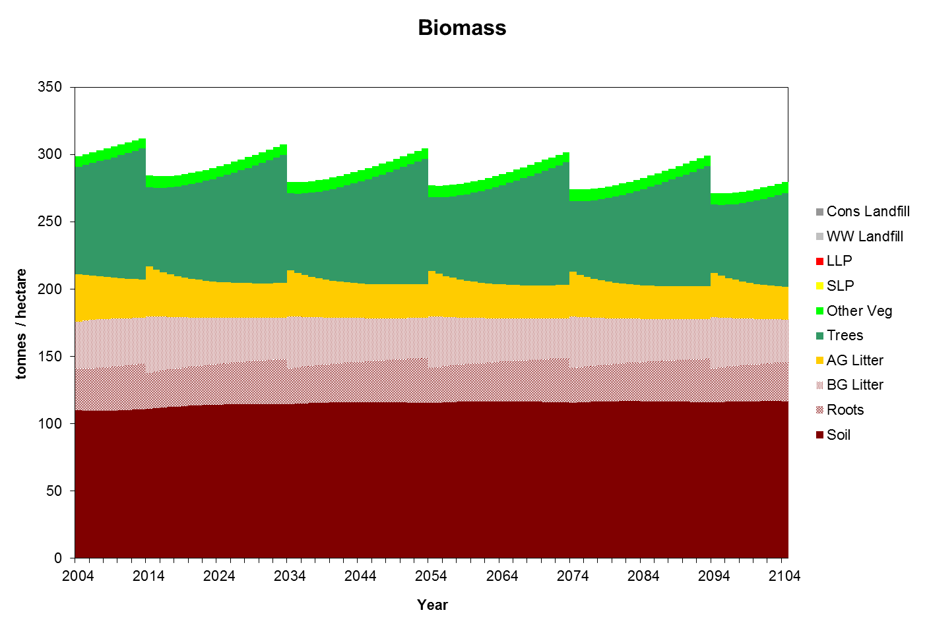
Forest management - 2
Traditional forest management was based on revenue maximization:
Max Revenue(u) s.t. B ≥ B on a certain time horizon (100 years?)
Where the decision vector u has 2 components: T, i.e., the period of the operation (e.g. : every 3, 5, 20, 50,… years), and R, i. e. , the percentage of above ground biomass removed. The constraint is normally set to prevent deforestation.
Note that the (high frequency – a cut every 20 years) periodic input is progressively attenuated by the filtering properties of the system. The soil content practically does not change.

Slide 22
Forest management - 3
If the objective is maximum C sequestration, the problem becomes:
Max C_{flux}(u) s.t. B ≥ B
The decision vector remains the same and the constraint may be less relevant since the solution will certainly imply a non zero biomass of the forest.
However, the carbon flux stored by the forest is normally much less relevant than the C spared by using forest biomass as a substitute for fossil fuel.
This means that the wood is “burnt” to produce energy (thus releasing the C stocked during growth), but avoids the release of a correspondent amount of fossil energy (i.e. bioenergy is “carbon neutral”).than the C saved

Slide 23
Forest management - 4
The problem is thus:
Max (C_{flux}(u) + C_{avoided}(u)), possibly s.t. B ≥ B and/or Litter ≥ L and/or
Avg(Revenue) ≥ Rev
C_{avoided}(u) depends on how the biomass is used to produce energy in order to compute the equivalent fossil fuel.
Examples:
centralized combined heat and power plants
domestic heaters
district heating systems
conversion to liquid fuels
…
To correctly compute the avoided emission, one should take into account the whole energy conversion process – LCA (e.g., transportation of biomass requires more energy than transportation of fossil fuel).

Slide 24
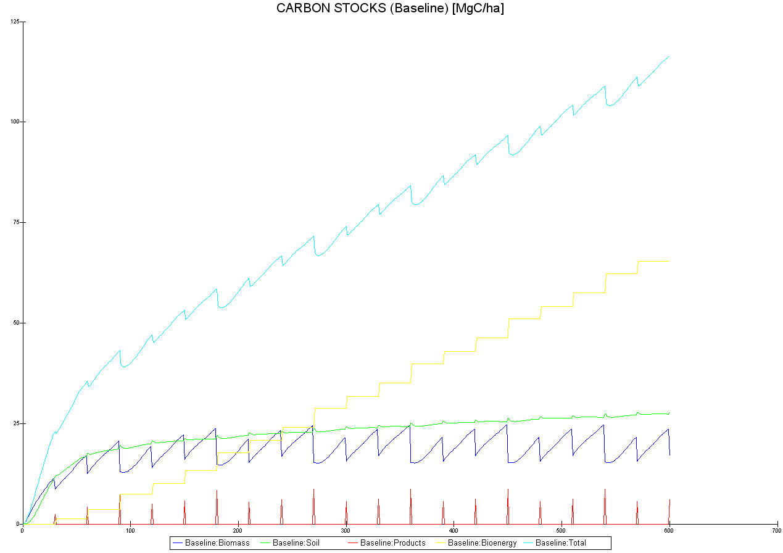
CO2fix Model Simulation:
Scenario = harvest for biomass only, northern hardwood stand, UVM Jericho Research Forest
125
100
Total carbon sequestration + emissions offset
75
Carbon (Mg/ha)
Biofuel offset of fossil fuel emissions
50
Soil carbon
25
0
100
200
300
400
500
600
Carbon in wood fuel
Years
Carbon in aboveground biomass
Data courtesy of Andy Book, Mike Thomas, and John Shane

Slide 25
Forest management - Conclusions
Asymptotically, any unmanaged forest is a carbon stock, but not a carbon sink, thus…
Only growing vegetation constitutes a carbon sink
Keeping the forest “young” may reduce the amount of litter (less dead material on the ground ≈ reduction of some ecoservices)
Modifying the soil cover (e.g., from forest to agriculture) implies a change not only of the above ground biomass (and C stock), but also of the soil C content
Avoided C emissions (bioenergy) are higher than sequestered C
Transients are always very long
The solution of forest management problems is normally periodic (only average values on a period are meaningful).

Slide 26
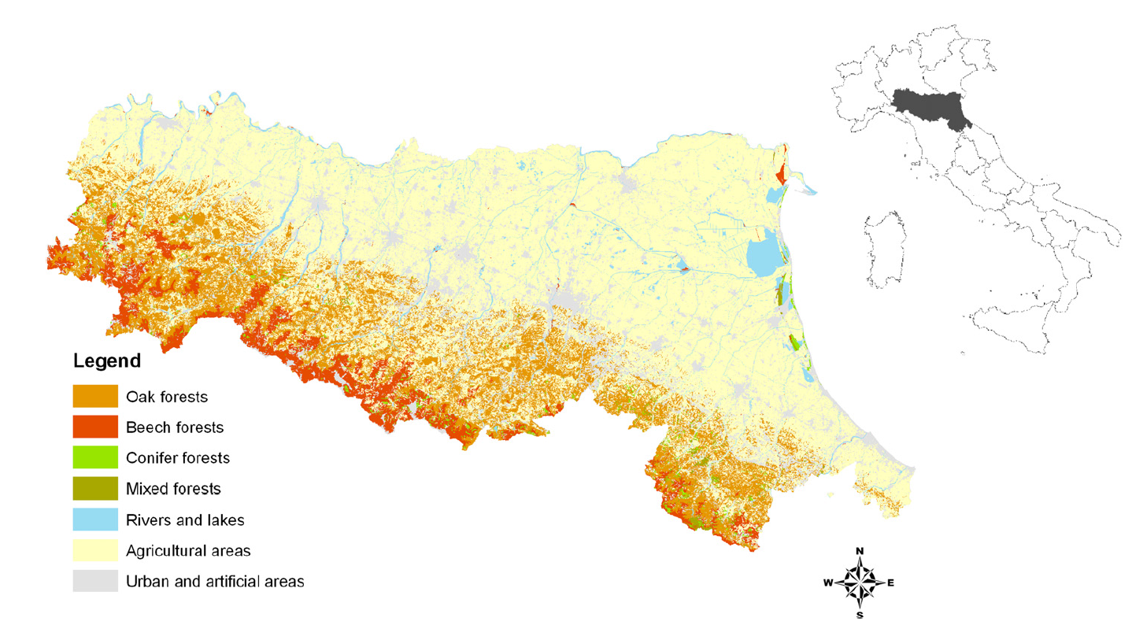
Case study – Emilia-Romagna region
Constraint on the minimum litter.
MAR = maximum annual removal ∼ max revenue
Overall CO₂ (sustainable) reduction = 300 kt/y
(675 without litter const.)
(10y)
possibly negative

Slide 27
Planning for the future
Drivers, technologies, external conditions are permanently evolving, thus a traditional plan, foreseen the actuation of a set of measures within a given horizon (5-10 years), will never materialize as planned. Some (technology driven) change are very fast.
Ex. the rapid diffusion of LED lights (the power of lights in a flat may be reduced up to 10 times);
car and bike sharing are substantially decreasing the number of cars.
It is necessary to move from traditional planning to a continuous control policy, that fosters the evolution in the planned direction, but considering the current situation.
Such a control policy can be based on what is known as the “receding horizon” in control theory and is being developed by sociologists and planners as “transition management”.

